Slide 1
I-20 over Wateree River and overflows
EARLY COORDINATION MEETING
March 24, 2022

Slide 2
Disclaimer
All information provided today is for information only, non-binding, does not constitute legal or other advice, and does not amend or form part of the Final Request for Proposals (RFP).

Slide 3
Purpose
Provide Information
Get Feedback & Answer Questions
Gauge Industry Interest & Competition

Slide 4
Agenda
Location/ Overview
Procurement Type
Scope of Work
Schedule
Q&A

Slide 5
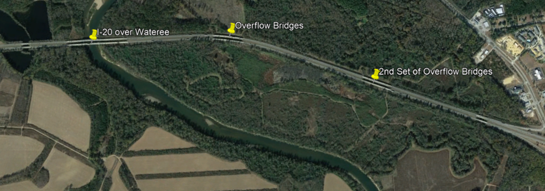
Project Location
Project is located in Kershaw County on Intestate 20 about 30 miles East of Columbia and about 2 miles South West of Camden.
Notes:
You can see the twin main river bridges over Wateree River and 2 sets of twins overflow bridges Just to the East of this location. What this does not include is the twin bridges to the west of the main river bridges and the twin bridges just before Exit 98 (521).

Slide 6
Anticipated Procurement Type
Two Phase Design-Build
ATC’s
Best Value
Weighted Criteria Formula
Notes:
Two Phase Design-Build will be our standard procurement time frame of approximately 10 months. For ATC’s we will probably be in the range of 20 PATC’s and 10 FATC’s Plan at this point this point is to be Cost – 55%, Technical Weight – 25%, and Added Value & Innovation Quality Credit Weight – 20%. Now is the time to have any questions or comments related to these items.

Slide 7
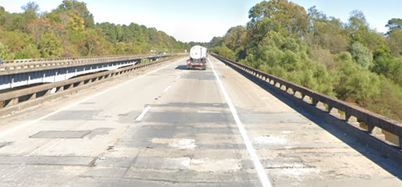
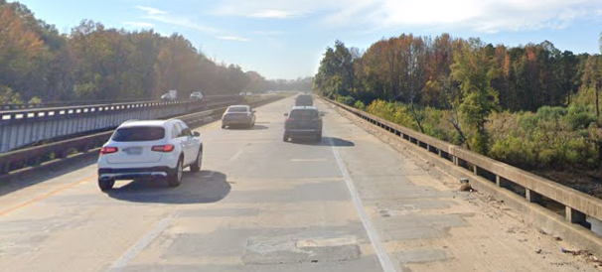
Anticipated Scope of Work
Replacement of the EB and WB Bridges
EB
WB
Notes:
The main river bridges will be replaced. Caver will give you more details on this in a few slides. You can obviously see one of the issues from these pictures with the deck patches.

Slide 8
Anticipated Scope of Work (main river bridge)
Demo Existing Bridge Structures
Build New Bridge Structures
Maintain two lanes of traffic in each direction during construction
Approach Roadways for New Structures
Notes:
Again, John will get in to more specifics next with the main bridges and the overflow bridge rehabilitation scopes.

Slide 9
Structures – Replace River Bridges
Removal of existing river pier footings (4 total)
Drilled shafts required at interior bents.
Superstructure type: girder bridge (steel or concrete)
Specified offset (10 feet) from existing pile bents
Deck: Galvanized rebar & 8.5” minimum thickness
Temporary Bridge Criteria: prefab steel. Must load rate.

Slide 10
Structures – Overflow Rehab Scope
Existing Flat Slabs (15 spans @ 30’ = 750’ each)
Partial-depth patching, spall repairs, new wing-walls
Expansion joint rehabilitation (new headers for some)
Approach slab replacement & flow-fill voids at end bents
Existing concrete piles in good shape

Slide 11
Roadway
75 mph design speed
Maintain two lanes each direction
Improve shoulders to standard at replacement
No shoulder reduction at rehab locations
Tie back in prior to Pond bridges (western end)

Slide 12
Utilities
SCDOT has performed preliminary coordination efforts.
Will provide SUE information through confidential means (new process)

Slide 13
Traffic
Published lane closure restrictions available on SCDOT’s public website.
Maintain two lanes in both directions at all times for bridge replacement.

Slide 14
Environmental
General Information
Having multiple environmental documents allows for option to permit activities separately to help with scheduling.
Mitigation for impacts can be covered by approved banks and will be team’s responsibility.
Overflow Bridges
PCE provided
Contractor responsible for permitting. Anticipate very minor impacts and hope to avoid permits if possible.
DOT GP available for use by team.
No major environmental resource constraints identified.

Slide 15
Environmental
Wateree River Bridges
CE will be provided.
Contractor responsible for permitting. Coast Guard permit not required.
DOT GP available for use.
Section 10 water so specific considerations will need to be given to navigation impacts in permit.
Sturgeon –TBD
Other than river crossing, no major environmental constraints identified.
Re-evaluation possible if deviate from overall footprint or increase impacts.

Slide 16
Anticipated Project Schedule
RFQ –
May 11, 2021
RFP for Industry – July 2022
Final RFP – September 2022
Public Announcement – March 2023
Contract Execution –
April 2023
Construction
Duration

Slide 17
Project Budget
$100 M approved in the STIP

Slide 18
Anticipated Project Information
Survey
Hazardous Materials Surveys
Hydrology Report
Structures
SI&A sheets
Preliminary Utility Report
Environmental
JD and line work for wetlands
NEPA document
Geotech Report

Slide 19
Questions/ Discussion

Slide 20
Feedback
Email: reynoldsbs@scdot.org

